Slide 1
The Future of Learning
Paul Collins
Director of Business Development
Boston College

Slide 2
Learning Technology – The Future

Slide 3
Future Scanning - Delivery
Technology already exists – although not the sparkling glasses that pop out the side of your head…
Virtual Reality Welding coming to Boston College
Likely to be still largely state driven – but it could be privatised, and in a way it is
Back to the future – a need to recognise the value of learning for its own sake
Why should learning only be funded from 3 to 18
MOOCs (massive open online courses)

Slide 4
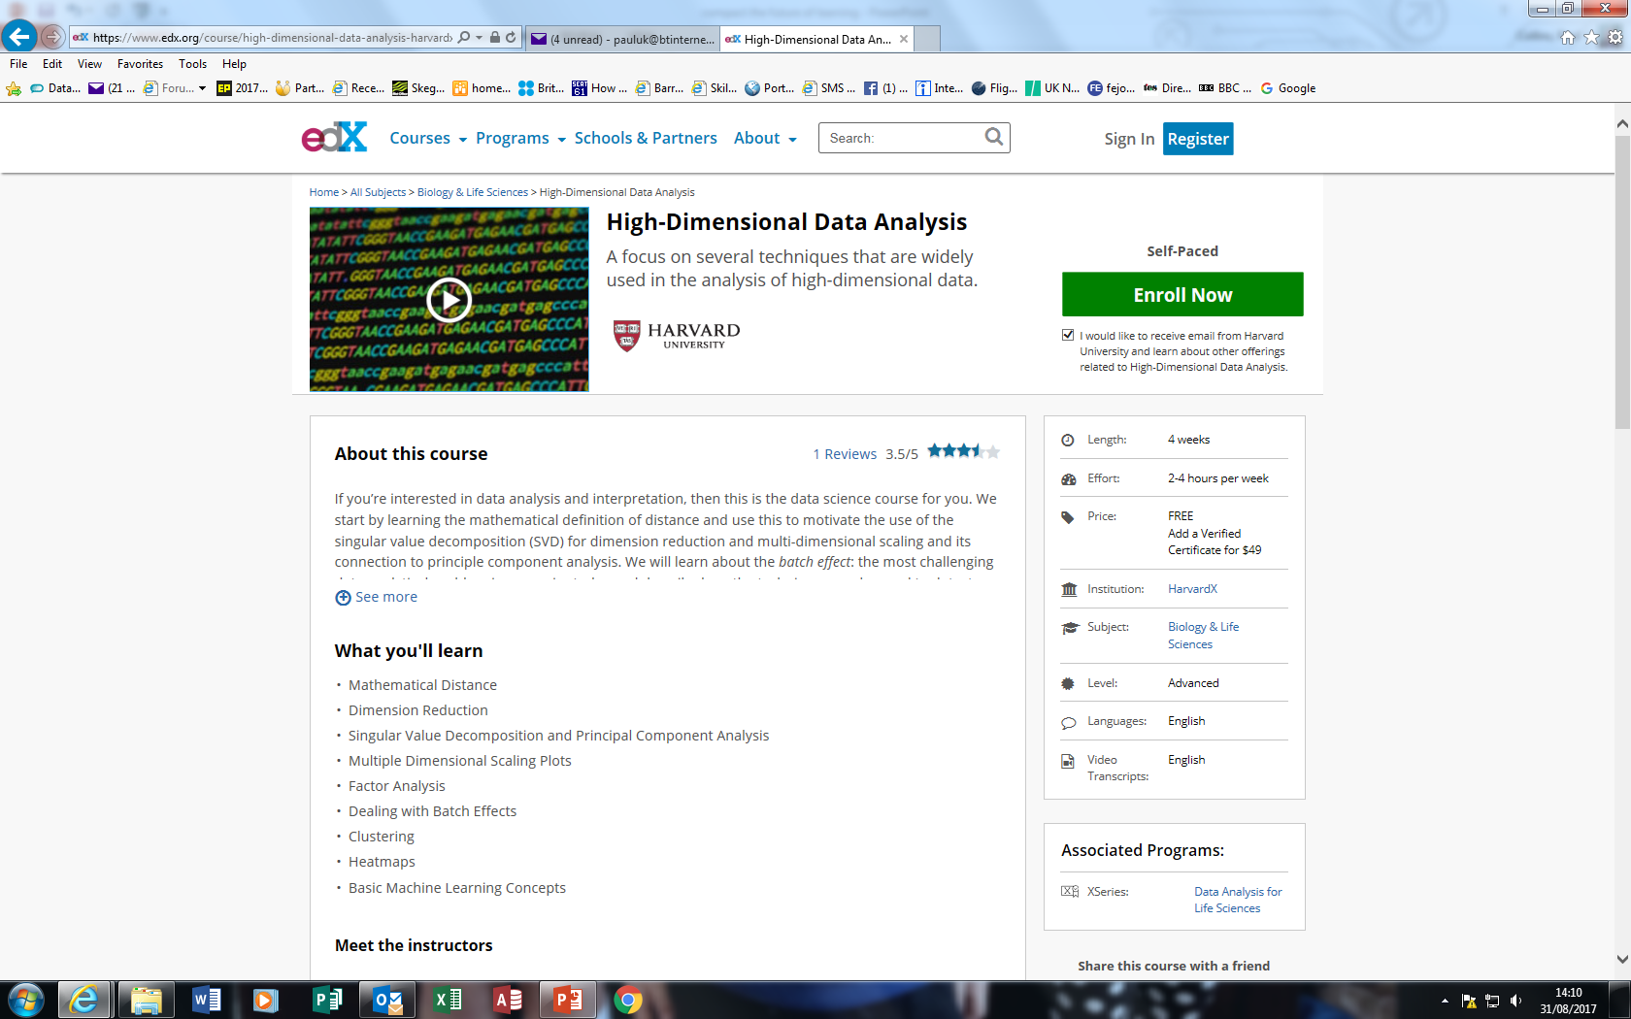

Slide 5
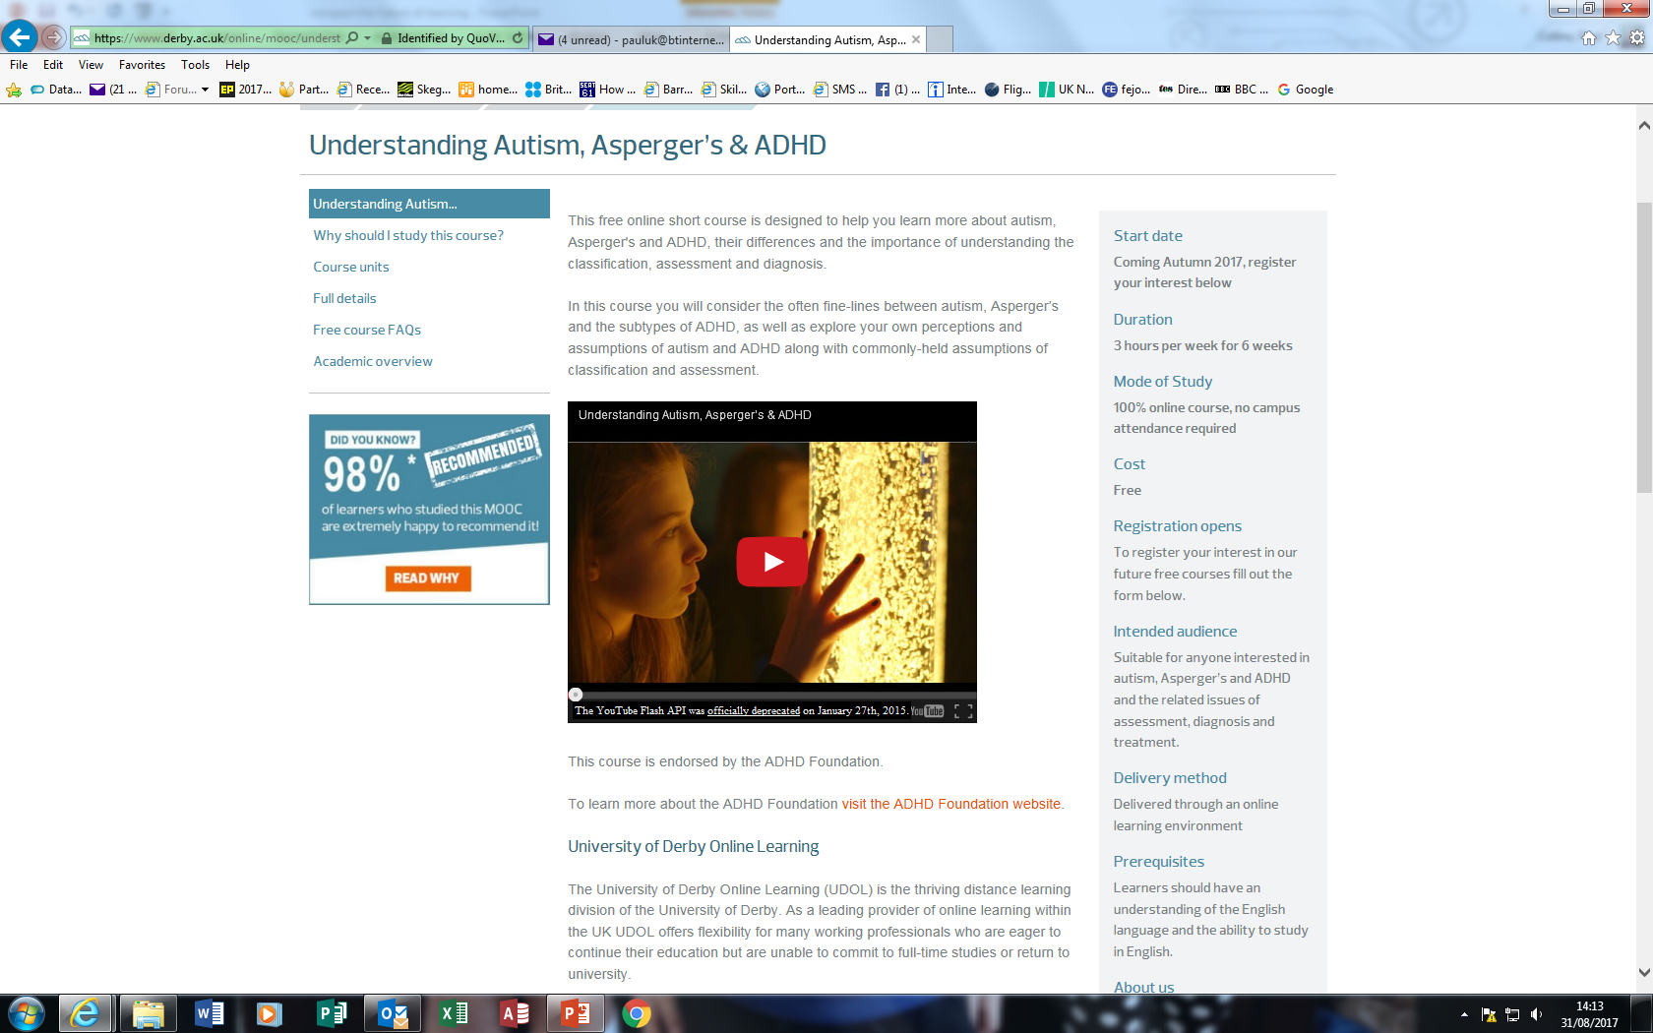

Slide 6
Technology - Improving Access

Slide 7
Technology – the good, the bad and the ugly…
Can improve access in a variety of ways
Can make learning more enjoyable
Doesn’t always work
Is expensive
Could reduce peer group interaction
Can leave young people with a history they don’t want
Means that people can say something instantly – that they possibly shouldn’t…..

Slide 8
Technology – Making Learning Fun

